Slide 1


Slide 2
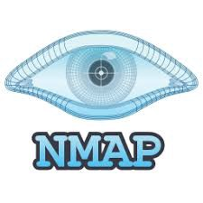
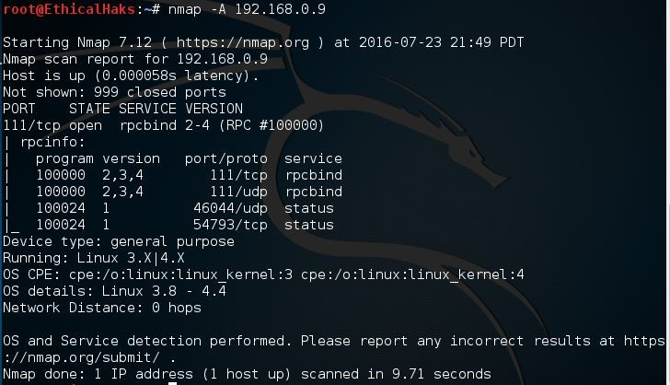
NMap
Nmap, short for Network Mapper, is a free, open-source tool for vulnerability scanning and network discovery.
Security Researchers use Nmap to identify what devices are running on their systems, discovering hosts that are available and the services they offer, finding open ports and detecting security risks.

Slide 3
Nmap Commands for Port Scanning and Reconnaissance
Target Specification in Nmap
nmap 192.168.1.1 ➔ Scan a single IP
nmap 192.168.1.1 192.168.2.1➔Scan specific IPs
nmap 192.168.1.1-254 ➔Scan a range
nmap scanme.nmap.org ➔Scan a domain

Slide 4
Host Discovery with Nmap
nmap 192.168.1.1-3 –sL➔ No Scan. List targets only
nmap 192.168.1.1/24 –sn➔ Disable port scanning. Host discovery only.
nmap 192.168.1.1-5 –Pn ➔ Disable host discovery. Port scan only.
Port Specification with Nmap
nmap 192.168.1.1 -p 21 ➔ Port scan for port x
nmap 192.168.1.1 -p 21-100➔Port range
nmap 192.168.1.1 -p- ➔Port scan all ports

Slide 5
Service and Version Detection
nmap 192.168.1.1 –sV ➔Attempts to determine the version of the service running on port
nmap 192.168.1.1 –A➔ Enables OS detection, version detection, script scanning, and traceroute .
OS Detection
nmap 192.168.1.1 –O ➔ Remote OS detection using TCP/IP stack fingerprinting

Slide 6
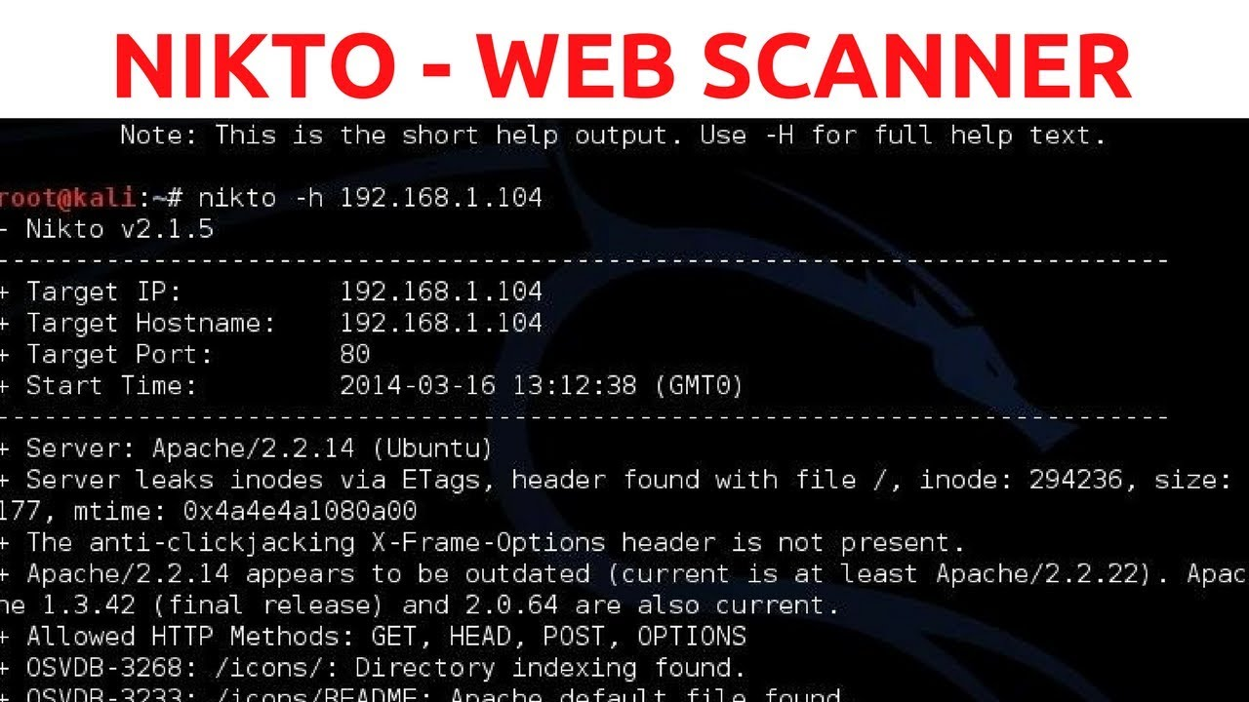
Nikto
Nikto is an Open Source web server scanner which performs comprehensive tests against web servers for multiple items.
Nikto is not designed as a stealthy tool
Nikto find potential problems and security vulnerabilities, including:
Server and software misconfigurations
Default files and programs
Insecure files and programs
Outdated servers and programs

Slide 7
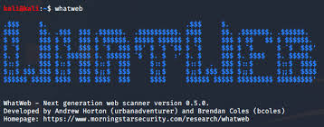
Whatweb
WhatWeb identifies websites.
It recognizes web technologies including content management systems (CMS), blogging platforms, statistic/analytics packages, JavaScript libraries, web servers, and embedded devices.
Whatweb can identify all sorts of information about a live website, like:
Platform
CMS platform
Type of Script
Google Analytics
Web server Platform
IP address, Country
900+ Plugins & their libraries used
Server Headers, Cookies and a lot more.

Slide 8

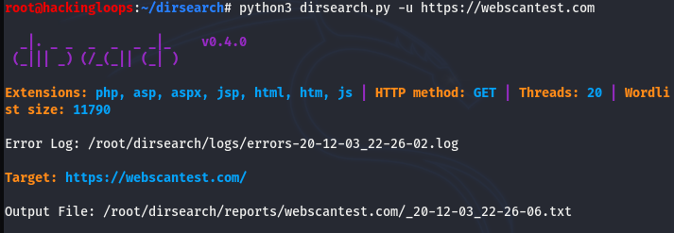
It is a Python-written method used to brute-force web directories and files that are secret.
Steps to install:
git clone https://github.com/maurosoria/dirsearch.git
cd dirsearch
pip3 install -r requirements.txt
dirsearch -u <URL> -e <EXTENSIONS>
dirsearch -u https://target
dirsearch -u target.com -e php,asp,aspx,jsp,py,txt,conf,config,bak,backup,swp,old,db,sqlasp,aspx,aspx~,asp~,py,py~,rb,rb~,php,php~,bak,bkp,cache,cgi,conf,csv,html,inc,jar,js,json,jsp,jsp~,lock,log,rar,old,sql,sql.gz,sql.zip,sql.tar.gz,sql~,swp,swp~,tar,tar.bz2,tar.gz,txt,wadl,zip,json,html,css,java,xml --full-url

Slide 9
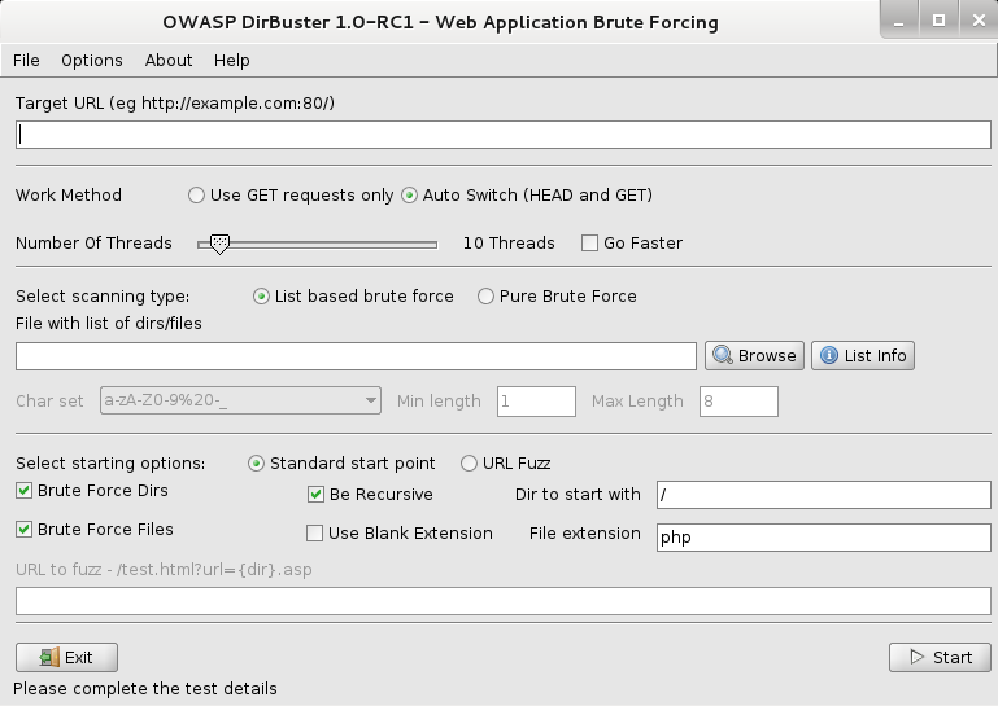
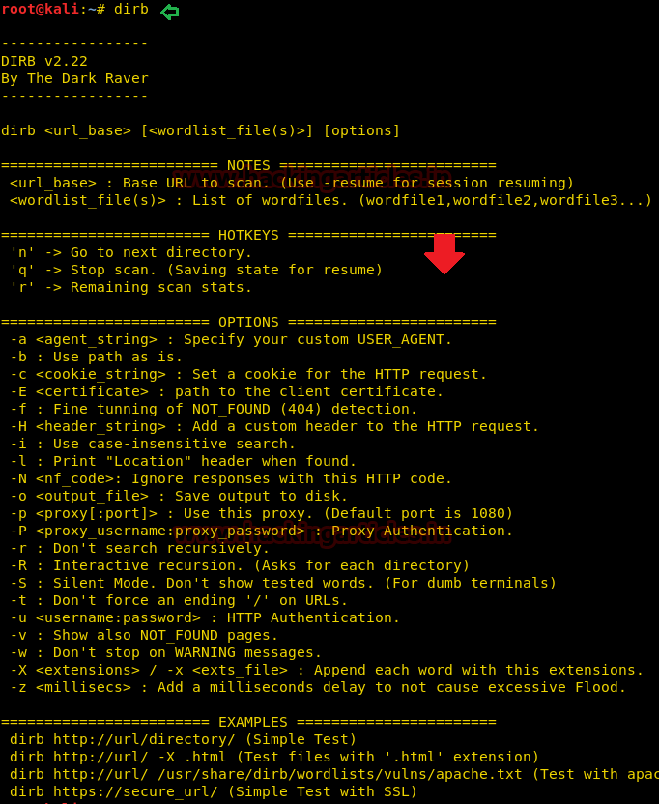

DirBuster is a penetration testing tool with a Graphic User Interface (GUI) that is used to brute force directories and file names on web and application servers.
DIRB is a command line based tool to brute force any directory based on wordlists

Slide 10
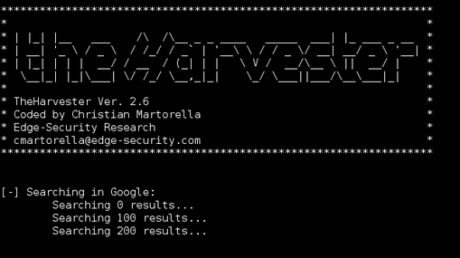
The Harvester is a tool that was developed in python. Using this you can gather information like emails, subdomains, hosts, employee names, open ports and banners from different public sources like search engines
theharvester -d [domain name] -b [search engine name]

Slide 11
Thank you

